Slide 1
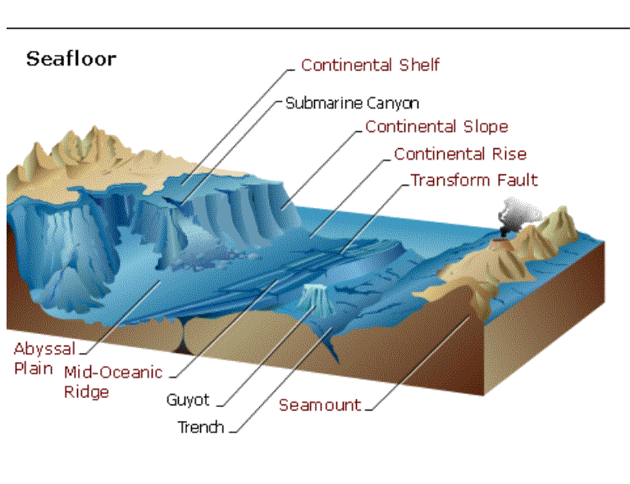
The Realms of Water
Submarine Relief

Slide 2
Hydrosphere
71% of total surface of the earth
Term ‘sea’ used for water bodies close to continental margins
Great mass of water surrounding oceans called ‘oceans’

Slide 3
Submarine relief
Ocean floor not plain
Highly rugged floors created due to four processes due to interactions of
Tectonic
Volcanic
Erosional and
Depositional processes
Four major divisions

Slide 4
Ocean floors
Continental Shelf
Continental Slope
Continental Rise
Abyssal Plains
Other associated features
Ridges
Hills
Seamounts
Guyots
Trenches
Deeps and fracture zones.

Slide 5
Continental Shelf
Slightly inclined, inundated zone forming borders of continents
Gently sloped with a depth of upto 200 metres, width varies with slope
Almost absent in the Pacific Ocean
Most of marine food is available here
Growth and reproduction of marine life possible
Richest fishing grounds
Potential mining sites
Large stores of sand and gravel

Slide 6
Continental Slope
Edges of the continental shelves
Becomes steeper
Extends upto depth of 3,660 metres
Beyond the slope, lies continental rise
Area of gentle slope with low relief
With increasing depth, becomes flatter
Eventually merges with the abyssal plain

Slide 7
The Abyssal Plains
Begins where the continental slope ends, abyssal plains begin
Almost flat areas with gentle gradient
Depth varies from 3600 to 6000 metres
Extensive areas covering 40% of total ocean floors
Present in all major seas and oceans

Slide 8
Miscellaneous features
Submarine ridges
Underwater mountain ranges few hundred km wide and several thousand km in length
Longest mountain system of the earth
Located in the centre of all oceans
Tectonic forces responsible for creation
Abyssal Hills
Thousands of hills submerged
>1000m above sea level called a ‘seamount’
Flat topped seamounts called ’guyots’
Volcanic origin

Slide 9
Miscellaneous features
Submarine trenches or Deeps
Long, narrow and steep sided depression
Deepest part of ocean bottom with usual depths of 5,500 metres
Formed due to subduction of tectonic plates
Most common in Pacific Ocean

Slide 10
MARINE LIFE AND DEPOSITS
Total area from the coast to greatest depth- marine environment
Large variety of flora and fauna
Open ocean environment- entire mass of water
Depth of 200 m- fishes
More than 200 m deep- hardly any varierty
Part of ocean populated by organisms
Littoral zone- high and low tide levels- plenty of animal food
Deep Sea Zone- mostly carnivorous organisms

Slide 11
Modes of Marine Life
Planktons
Minute plant and animal organisms- float or drift in ocean waters.
Use sunlight and mineral nutrients for food
Chief food for fish any many other animals
Benthos
Found on ocean floors. Lobsters, crabs, snails and worms, seaweeds and eelgrasses.
Live in shallow water to receive sunlight
Nekton
Swimming organisms- fishes, whales, dolphins etc.
Feed on planktons move from place to place

Slide 12
Marine Vegetation
Mostly algae- primitive plant form, no body organs
Contain chlorophyll
Epithytic- growing on plants
Epizoic- growing on animals
Beautifully coloured- blue-green, green, red and brown
Corals- skeletons of minute sea organisms-polyps
2500 species of polyps, Live in colonies
New structures build upon older dead structures
In course of time, reefs are formed

Slide 13
Marine Deposits
Two main groups
Terrigenous deposits-
Mainly found on continental shelf and continental slope
Deposits material taken from land
Carried by rivers, wind and other agents of change
Gradual decrease of coarseness from coast to deep sea
Gravel, sand and mud
Pelagic deposits
Shells and skeletons of marine animals and plants
Found in mid-oceans away from continents
Some volcanic dust brought by wind
Both organic and inorganic

Slide 14
SALINITY OF OCEAN WATERS
Every known element found in oceans
Salinity- 77% NaCl2, magnesium, calcium and potassium
Proportion of different salts remain constant in all oceans due to free movement of water
Degree of concentration of salt solution vary- salinity- degree of saltness of water.
Average salinity- 35.2%, 35 parts of salt in 1000 parts of water
Baltic Sea- 7%, Red Sea- 39%, Caspian Sea- 180%, Dead Sea- 250%- impossible to sink
Salinity affected by various factors-
Rate of evaporation-
Amount of fresh water added by precipitation, streams and icebergs
Degree of water mixing by currents

Slide 15
TEMPERATURE OF OCEAN WATERS
Variation in temperature from surface to depths
Annual range of temperature is very small
Temperatures decrease from equator to the poles, reduction never constant due to interference by ocean currents, winds and air masses
Highest water temperatures- enclosed seas in tropics
Arctic regions- frozen ice-packs till few feet
Temperature varies vertically with increasing depth
Decrease rapidly by 1°F for first 200 fathoms, slower till 500
Less than 1°F beyond 500 fathoms every 100 fathoms
In waters below 2000 fathoms, very cold, never freezes.

Slide 16
OCEAN WATER MOVEMENTS
Ocean waers are never stable, Keeps on moving horizontally as well as vertically.
Movement takes place in three ways-
Ocean Waves
Ocean Currents
Tides

Slide 17
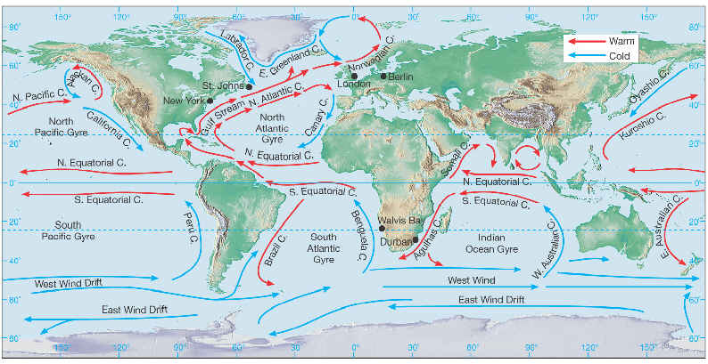
OCEAN CURRENTS

Slide 18
Ocean currents
Large masses of ocean waters, circulate in regular patterns
Warm currents- equator towards poles
Cold currents- polar regions to equator
Factors affecting their movement
The planetary winds
Temperatures
Salinity
Earth’s rotation
Land

Slide 19
The Planetary Winds
Trade Winds- warms eastern coasts of continents in their belt
Westerlies- warms western margins of continents in their belt
Strongest evidence of winds dominating currents are seen in the Indian Ocean
Direction of currents change with the direction of the monsoons- SW in summer and NE in winter

Slide 20
Temperature
Much difference in temperature near the equator and at the poles.
Warm water is lighter, it rises, cold water is denser so it sinks
Warm equatorial currents move slowly along the surface
Heavier cold currents move equatorwards along bottom of the seas and oceans

Slide 21
Salinity
Waters with high salinity are denser
Low salinity water floats on the surface of water having high salinity and vice versa
Mediterranean region- less saline waters of Atlantic ocean flows on the surface of more saline Mediterranean waters.

Slide 22
Earth’s rotation
Coriolis force deflects freely moving waters towards their right in the NH.
Clockwise direction- Gulf Stream & Canaries
Anti-clockwise in SH- Brazilian & West Wind Drift

Slide 23
Land
Any land mass when obstructs a current, it diverts the current
Tip of Southern Chile diverts part of West Wind Drift northwards as Peruvian Current
Greenland deflects the Polar Easterlies towards the equator as Labrador & East Greenland Current
Brazilian ‘shoulder’ deflects the equatorial current into Brazilian current

Slide 24
Circulation of the Atlantic Ocean
North and South Equatorial Currents
North Atlantic Ocean
Caribbean Current
Florida Current
Gulf Stream-westerlies take it towards Europe as North Atlantic Drift
Cools as Canaries current, moves equatorwards
Merges with the equatorial currents
Labrador & East Greenland Currents
South Atlantic Ocean- Same pattern as in the north
Brazilian Current
Merges with the west wind drift
Benguela current
Joins the south equatorial current

Slide 25
Circulation of the Pacific Ocean
Similar to Atlantic with some modifications due to greater size and more open nature
Northern Pacific Ocean
North Equatorial current
Kuroshio current- North Pacific Drift
Oyashio current
Returns back as Californian Current
Combines with the North Equatorial Current
Southern Pacific Ocean
South Equatorial Current
East Australian Current
Merges with West Wind Drift
Peruvian Current
Links with the South Equatorial Current

Slide 26
Circulation of the Indian Ocean
South Indian Ocean form a closed circuit
Equatorial Current
Mozambique Current in Madagascar
Merges with the West Wind Drift
West Australian Current equatorwards
North Indian Ocean
Complete reversal of direction in summer & winter
Summer- SW
Winter- NE
Dominating effects of winds over ocean currents

