Slide 1
Age and Origin of the Earth

Slide 2
Age of the earth
Mysterious
Varied and contrasting results
Impossible to arrive at an acceptable conclusion
4 to 5 billion years old
Modern methods- last two centuries
Tidal Force
Sedimentation
Rate of erosion
Salinity of the oceans
Radioactivity

Slide 3
Tidal Force
Moon formed from earth.
Was very close at the time of its birth
Tidal friction was maximum
As moon moved away from earth, tidal friction reduced.
Rate of reducing friction used to calculate age of the earth- 4 billion years

Slide 4
Tidal Force
Scientific study of tides and rotation of earth
Moon-moving away from earth @13 cm a year
Current distance- 3,84,000 km from earth
2.95 billion years at this rate
Earth is older than moon- so approx. 4 billion years old.

Slide 5
Sedimentation
Process of sedimentation continued from time when earth started cooling down- still on
Thickness of the sedimentary rocks and annual rate of thickening
Help in estimating age of the earth
Age of the earth- thickness of sediment
annual rate of deposit of the sediment
Approx 5 billion years- erosion started after 1 billion years after formation of crust

Slide 6
Rate of erosion
Denudation- erosion of landmasses
If we find out total amount of denudation and annual rate of denudation,
Not a very accurate method

Slide 7
Salinity of the oceans
Initially oceans had fresh water
Erosion and deposition of salt from continents
If we know total amount of salt and annual rate of increase in salinity, age of ocean can be determined
Age of oceans- Total oceanic salt
Annual rate of oceanic salinity

Slide 8
Salinity of the oceans
Mass of salt calculated- 156 metric tonnes per year
Total amount of salt present- 12.5 billion tonnes.
Age of oceans- approx. 0.8 million years
Age of the earth- 40 mya than formation of oceans- 120 mya.- incorrect theory
- Salt evaporates and deposits elsewhere.
- Erosion is not uniform everywhere

Slide 9
Radio activity
Most reliable, accurate, very popular
Discovered by Pierre Curie in 1903
Radioactive elements disintegrate and generate heat- uranium and thorium
If we know rate of disintegration of these and mass of remaining elements.
Rate of disintegration expressed as Half-Life period.
For eg- Uranium loses 1/2 of its mass in 4.6 bill years
From this age of earth- 4 to 5 billion years

Slide 10
Origin of the earth
Still debatable.
Different scholars express different views.
Most of them believe that it originated from the sun.
Some hypothesis used to explain
Gaseous Mass Hypothesis of Kant
Nebular Theory of Laplace
Planetesimal hypothesis of Chamberlain and Moulton
Tidal Collison hypothesis of Jeans and Jaffreys
Electromagnetic theory of Dr. Hannes Alfven
Inter-stellar Dust Hypothesis of Otto Schmidt

Slide 11
Gaseous Mass Hypothesis of Kant
Imanuel Kant- German Scholar- 1755
Primitive matter was evenly distributed in gaseous form
Attracted towards each other, collided- increase in temperature, caused rotation due to angular velocity
Eventually high temp and rotation speed became so high, the mass became gaseous and started emitting light.
Rings began to separate(centrifugal force), on cooling became planets.

Slide 12
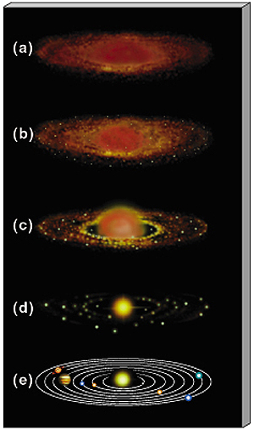

Slide 13
Nebular Theory of Laplace
Laplace- French Mathematician- 1796
Primitive matter in gaseous and in rotating state- called nebula
Gradually it cooled, volume decreased, speed of rotation increased, generating centrifugal force.
When CF< GF, one ring of gases escaped, broke into many smaller rings
These rings became planets and satellites

Slide 15
Planetesimal hypothesis of Chamberlain and Moulton
T.C Chamberlain & F.R Moulton- 1904
Initially two heavenly bodies- our proto-sun and a companion star- much bigger than the sun.
As the companion star approached the sun, the great GF led to ejection of jets of solar matter to great distances- planetesimals.
Larger planetesimals became nuclei, started attracting smaller ones, formed planets.
Remaining part of the nebula became the sun.

Slide 16
Tidal Collison hypothesis of Jeans and Jaffreys
Sir James Beans & Harold Jaffreys- British scientists- 1919 & 1929
Sun was a gaseous mass. Another star came close to it, pulled some material from the sun due to its gravitational pull- similar to process of tides on earth.
Bigger star continued to move on its path, the ejected material started revolving around the sun- cooled to form planetesimals.
Attrition of these planetesimals created planets

Slide 17
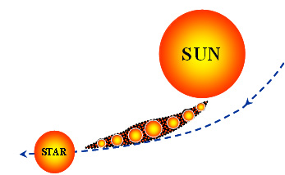

Slide 18
Electromagnetic theory of Dr. Hannes Alfven
Based on electromagnetic force- 1942
Sun is surrounded by strong magnetic field. This electromagnetic field much stronger than its GF.
Sun was revolving very fast, during its journey it entered into a massive dust cloud. These dust particles were attracted by the magnetic field and started revolving round the sun, got ionized after colliding with each other.
Planets were formed when these ionized particles condensed.

Slide 19
Inter-stellar Dust Hypothesis of Otto Schmidt
Russian scientist- 1943
Dust and gas particles- scattered in space, having their own angular momentum
Attracted towards the sun and started revolving
This movement caused redistribution and rearrangement of particles according to size and density.
Coalescense of these particles made them bigger to form esteroids. Grew bigger in size became planets.

Slide 20
BIG BANG THEORY
Expanding universe hypothesis- Edvin Hubble- 1920, validated in 1972.
Everything originated from a point-singularity
Gigantic explosion- 15 billion years ago, energy converted into matter, first atoms began to form
Matter expanded to form billions of galaxies, in time with their stars with their planets
Our solar system is at the edge of the Milky Way Galaxy as a cold and diffused gas cloud.
Galaxies started moving away from each other.

Slide 21
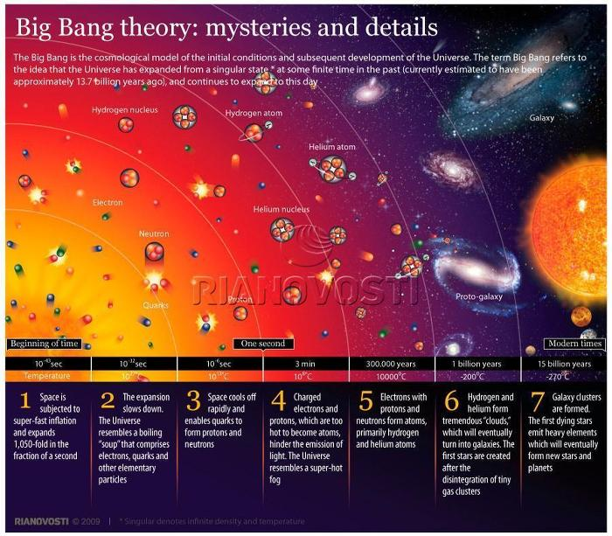

Slide 22
STEADY STATE
Hoyle- alternative to Big Bang
Universe has remained the same over time.
His theory did not find much favour.
With larger evidences available, even the Big Bang Theory is also criticized on various grounds.

